Slide 1
Pupil Parliament Minister presentation to Coppice School Governors
Presented by:
Health & Medical Minister

Slide 2
Pupil Parliament at Coppice School
At Coppice School Pupil Parliament is like the government. It is made up of different ministers. Each of the ministers helps to improve Coppice School.
Our newly elected Ministers:
TC - Communication & Independence Minister
LL - Provision & Resources Minister
DS- Environments Minister
EF - Displays Minister
JBB - Social Time Minister
OS - Pupil Wellbeing Minister
OD - Health and Medical Minister

Slide 3
Pupil Parliament at Coppice School
Pupil Parliament promotes pupil leadership opportunities. Enabling us to develop communication, organisation and other skills, through key roles of responsibility and new experiences.
Aims of our Pupil Parliament:
Represent all pupils and include a fair representation of the school.
Take time to listen to all pupils and communicate their needs.
Feedback to pupils about what happened about their views.
Action decisions that have been made or explain why they can’t happen.

Slide 4
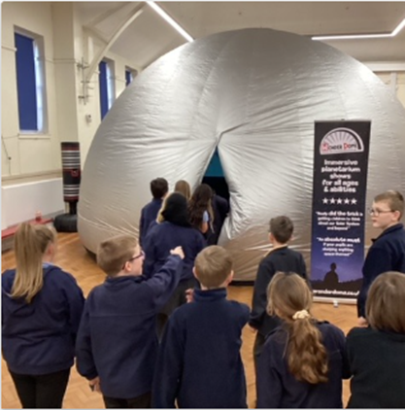
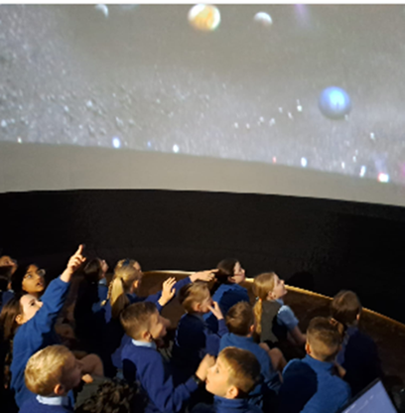
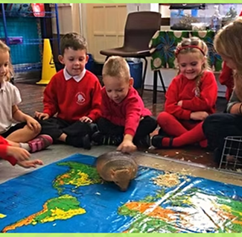
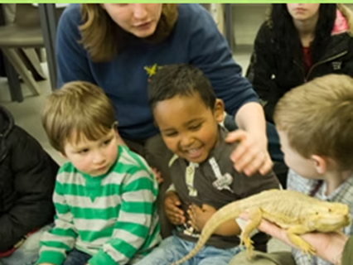
Pupil Parliament at Coppice School
This term we have collected Pupil Voice for Cross-Trust Projects – suggestions:
• 5-a-side football
• Basketball - Half-court games or skill challenges like dribbling and shooting contests.
• Circuit training - Stations for different exercises like star jumps and push-ups.
• Boccia - suitable for learners of all abilities.

Slide 5
Pupil Parliament at Coppice School
Other Pupil Parliament/Pupil Voice Priorities:
What students would like to do at Breaktimes and Lunchtimes to have more social opportunities and make friends.
What students would like to help them feel happy and settled during Breaktimes and Lunchtimes – OD’s ideas: quiet zone – more ear defenders, bouncy zone - trampoline, sensory toys zone, music zone – listening, singing and dancing.
Have Governors and/or any other suggestions for Pupil Parliament/Pupil Voice priorities?

