Slide 1
My plans for the future
How English and maths will help me
Notes:
This activity is designed to help you work with learners with SEND so that they
understand the relevance of maths and English to their future lives
recognise why it is important that English and maths feature in their curriculum.
It contains two separate tasks which can be incorporated into English, maths, Functional Skills, employability or tutorial sessions:
My Job: focused on English and maths for work (see slides 2-6)
My Life: focused predominantly on learners’ wider lives – living as independently as possible, being part of their communities and having an active social life (see slides 7-11).
Learners can do both tasks or just one, according to their needs. You could split each task into two, looking at English and maths separately or deal with the two areas together.
For a very few learners, work may not be an appropriate goal and so they might only use the ‘My Life’ activity. Where work is going to be a relatively small part of their adult lives, learners could just use the ‘My Life’ activity and include work within that.
Learners who are on a course, such as a supported internship, which has a very strong focus on employment might only use the ‘My Job’ activity.
Learners can use both activities if it would help to think about maths and English for work and for their adult lives more generally.

Slide 2
My job
How English and maths will help me

Slide 3

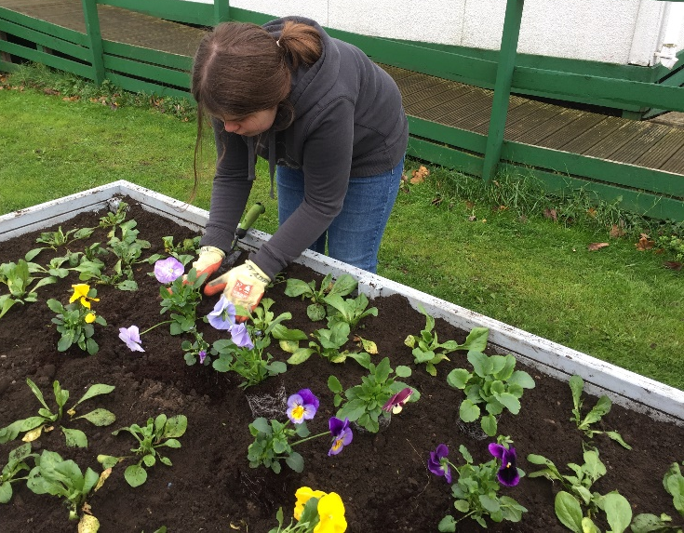
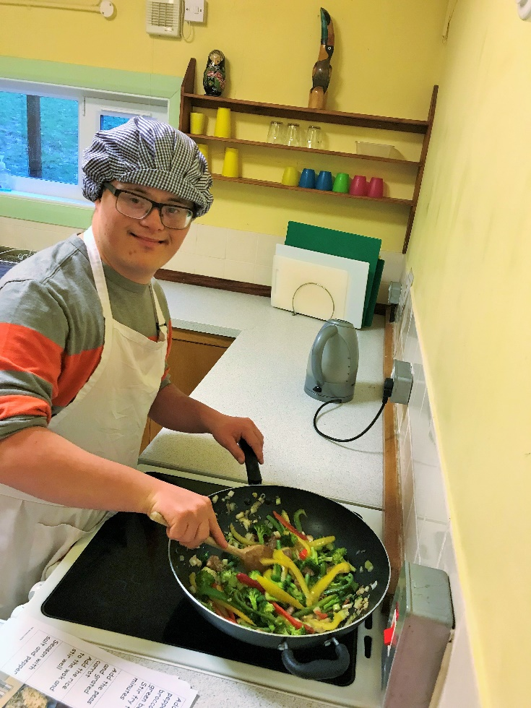

What job do I want?
Notes:
Ask learners to think about the type of job they want in the future.
You may need to spend some time on this question, depending how much exploratory work has already been done. Learners who are not sure could pick a general area (working with animals, for example, rather than kennel assistant) or focus in on one of a number of possible jobs that they are considering.

Slide 4
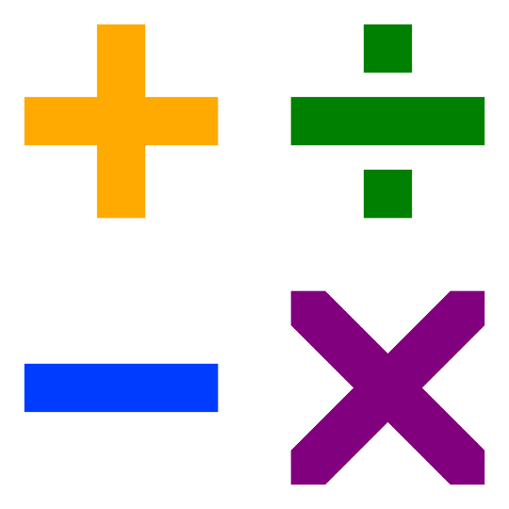


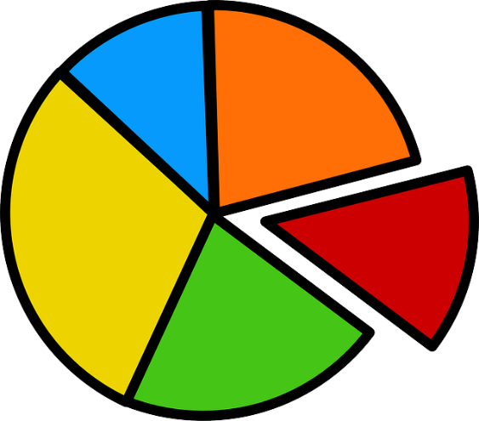
What maths skills will I need?
Notes:
You can substitute Makaton, Widgit or other symbols or words and phrases for the prompt pictures in these slides, as appropriate for your learners.
Encourage learners to think about the three key areas of: measure, shape and space; numbers and the number system; handling information and data. You may need to help learners recognise what ‘counts as maths’ at the level at which they are working. For example – measure, shape and space at pre-Entry may include seeing the difference between long/short or heavy/light; recognising days of the week; being able to sequence morning and afternoon; respond to positional vocabulary in an instruction; know the difference between top and bottom…
It can also be useful to take a specific activity and unpick the actual maths skills it entails. For example, checking sell-by dates on perishable items requires learners to be able recognise the date in different formats (e.g. 12.03.19, 12 March 2019, March 12) and determine whether a given date is the same as, comes before or comes after today’s date. Learners who also have responsibility for stacking shelves may be asked to ensure goods with earlier sell-by dates are placed at the front. This requires them to be able to sequence dates, sort by date and organise the goods within a given space.
You might find it useful to show one or more video clips of people carrying out a specific task at work (easily sourced from YouTube) in areas of interest to the learners. Some learners will find it easier to spot the English skills when they can see them in action, rather than thinking about it in theory. If you are looking at both maths and English skills in this activity, your learners could look for both sets of skills while watching a single video clip.
Try to keep the focus specific for each learner or group of learners with a shared job goal. Think about the particular job role/working environment and associated tasks and responsibilities. This will help show how maths is important for them as individuals.
You can also extend the discussion, potentially working with a whole group to more generic work-related activity and the maths skills involved with these: getting to and from work; waking up on time; taking breaks; booking leave; checking their pay….
It is not essential that learners capture all the maths skills inherent in their chosen job role; the purpose of the exercise is to help them see that there are lots of different elements of maths involved in work – and that is why maths is an important part of their curriculum.
Learners can use a print-out of slide 5 to record their ideas.

Slide 5




What English skills will I need?
Notes:
You can substitute Makaton, Widgit or other symbols or words and phrases for the prompt pictures on the slide, as appropriate for your learners.
Encourage learners to think about the three key areas of: reading, writing and speaking and listening or otherwise communicating. You may need to help learners recognise what ‘counts as English’ at the level at which they are working. For example – reading might be about recognising signs and symbols rather than words or phrases, following visual prompts/instructions; recognising their own name in a list or a familiar destination displayed on a bus.
Ask learners what different things they might need to read/recognise and why/when; when they might need to write something down or create text/images on a computer or digital device; who they might need to talk/otherwise communicate with, in what situations and for what purpose. When will listening be particularly important?
You might find it useful to show one or more video clips of people carrying out a specific task at work (easily sourced from YouTube) in areas of interest to the learners. Some learners will find it easier to spot the English skills when they can see them in action, rather than thinking about it in theory. If you are looking at both maths and English skills in this activity, your learners could look for both sets of skills while watching a single video clip.
Keep the focus specific for each learner or group of learners with a shared job goal. Think about the particular job role/working environment and associated tasks and responsibilities.
You can also extend the discussion, potentially working with a whole group to more generic work-related activity and the English skills involved with these: getting to and from work; booking leave; interacting with colleagues…
It is not essential that learners capture all the English skills inherent in their chosen job role; the purpose of the exercise is to help them see that there are lots of different elements of English involved in work – and that is why English is an important part of their curriculum.
Learners can use a print-out of slide 5 to capture their ideas.

Slide 6
My job
Notes:
Learners or teachers can customise this page with the name of the specific job role, a symbol or photo.
Learners can use it to record their ideas for English, maths and/or both sets of skills.
Or you could come up with another way to record and/or display their ideas.

Slide 7
Listen to customers’ orders
Put coins and notes in right place in the till
Use picture instructions for coffee machine
Give the right change
Set my alarm
Check sell-by dates. Put nearest dates at front of fridge
Work in a café
Write dish of the day on the blackboard
Chat with customers
Check if the bus is coming on my phone
Ask for help from my manager
Sort the plates by size

Slide 8
My life
How English and maths will help me

Slide 9

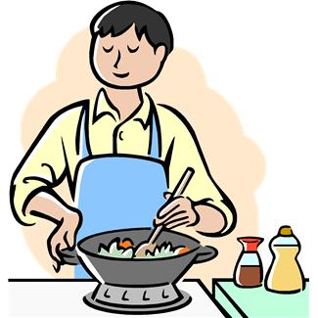
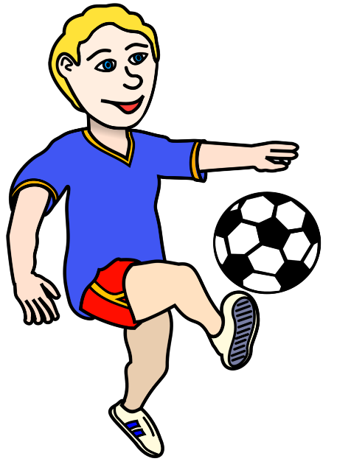

What do I want to do in my life?
Notes:
You can use this activity in addition to or instead of the previous ‘What job do I want?’ activity.
If they have already completed a one-page profile, an EHC Plan or captured aspirations for the future in another way, you can refer to this.
Encourage learners to think about
where they want to live, in what sort of housing, with whom (represented by the house in the top left corner)*
what do they want to be able to do for themselves – e.g. in terms of looking after themselves and their homes, or accessing their communities (represented by the images relating to travel, cooking and shopping in the top right corner)*
How they want to spend their spare time/socialise/keep active (represented by the images relating to activities in the bottom right corner)*
*You can substitute Makaton, Widgit or other symbols or words and phrases for the prompt pictures on the slide, as appropriate for your learners.
For some learners, it may be more appropriate to focus on just one area at a time, perhaps working with a particular goal that they have already identified, e.g. use public transport to get to and from town.

Slide 10
What maths skills will I need?
Notes:
You can substitute Makaton, Widgit or other symbols or words and phrases for the prompt pictures in these slides, as appropriate for your learners.
Encourage learners to think about the three key areas of: measure, shape and space; numbers and the number system; handling information and data. You may need to help learners recognise what ‘counts as maths’ at the level at which they are working. For example – measure, shape and space at pre-Entry may include seeing the difference between long/short or heavy/light; recognising days of the week; being able to sequence morning and afternoon; respond to positional vocabulary in an instruction; know the difference between top and bottom…
It can also be useful to take a specific activity and unpick the actual maths skills it entails. For example, checking sell-by dates on perishable items requires learners to be able recognise the date in different formats (e.g. 12.03.19, 12 March 2019, March 12) and determine whether a given date is the same as, comes before or comes after today’s date. Learners who also have responsibility for stacking shelves may be asked to ensure goods with earlier sell-by dates are placed at the front. This requires them to be able to sequence dates, sort by date and organise the goods within a given space.
You might find it useful to show one or more video clips of people carrying out a specific task at work (easily sourced from YouTube) in areas of interest to the learners. Some learners will find it easier to spot the English skills when they can see them in action, rather than thinking about it in theory. If you are looking at both maths and English skills in this activity, your learners could look for both sets of skills while watching a single video clip.
Try to keep the focus specific for each learner or group of learners with a shared job goal. Think about the particular job role/working environment and associated tasks and responsibilities. This will help show how maths is important for them as individuals.
You can also extend the discussion, potentially working with a whole group to more generic work-related activity and the maths skills involved with these: getting to and from work; waking up on time; taking breaks; booking leave; checking their pay….
It is not essential that learners capture all the maths skills inherent in their chosen job role; the purpose of the exercise is to help them see that there are lots of different elements of maths involved in work – and that is why maths is an important part of their curriculum.
Learners can use a print-out of slide 5 to record their ideas.

Slide 11
What English skills will I need?
Notes:
You can substitute Makaton, Widgit or other symbols or words and phrases for the prompt pictures on the slide, as appropriate for your learners.
Encourage learners to think about the three key areas of: reading, writing and speaking and listening or otherwise communicating. You may need to help learners recognise what ‘counts as English’ at the level at which they are working. For example – reading might be about recognising signs and symbols rather than words or phrases, following visual prompts/instructions; recognising their own name in a list or a familiar destination displayed on a bus.
Ask learners what different things they might need to read/recognise and why/when; when they might need to write something down or create text/images on a computer or digital device; who they might need to talk/otherwise communicate with, in what situations and for what purpose. When will listening be particularly important?
You might find it useful to show one or more video clips of people carrying out a specific task at work (easily sourced from YouTube) in areas of interest to the learners. Some learners will find it easier to spot the English skills when they can see them in action, rather than thinking about it in theory. If you are looking at both maths and English skills in this activity, your learners could look for both sets of skills while watching a single video clip.
Keep the focus specific for each learner or group of learners with a shared job goal. Think about the particular job role/working environment and associated tasks and responsibilities.
You can also extend the discussion, potentially working with a whole group to more generic work-related activity and the English skills involved with these: getting to and from work; booking leave; interacting with colleagues…
It is not essential that learners capture all the English skills inherent in their chosen job role; the purpose of the exercise is to help them see that there are lots of different elements of English involved in work – and that is why English is an important part of their curriculum.
Learners can use a print-out of slide 5 to capture their ideas.

Slide 12
My life
Notes:
Learners or teachers can customise this page with the name of the specific job role, a symbol or photo.
Learners can use it to record their ideas for English, maths and/or both sets of skills.
Or you could come up with another way to record and/or display their ideas.

Slide 13



Write messages to my friend
Pay the right money for drinks
Check if I have enough money
Read the numbers
on the bus
Count six stops to town
Notes:
You can use this example to show learners what you are expecting them to create.
This is a very simple version based on the aspirations of a pre-Entry learner who wants to be able meet friends in town and have fun together.
However, you can take any approach you like to capturing the maths and English skills they have identified, for example through video.

