Slide 1

Time for yoga
Get your yoga mat.
Sit in a space.

Slide 2
Tadasana
Stand up tall, breathe in and out.
Shrug your shoulders up, hold, then let them drop

Slide 3
Butterfly
Breathe in, raise your arms.
Breathe out and let them go back to your side.
Imagine opening your beautiful wings.

Slide 4
Head, Shoulders, Knees and Toes
Sing the song and do the actions.
Point to your facial features.

Slide 5
Tree
Stand up tall, breathe in and out.
Lift one foot to your knee, then lift your arms up.
Use a chair or wall for balance if needed.

Slide 6

Palm Tree
Stand up tall, breathe in and out.
Raise both hands above your head and link fingers.
Sway from side to side.

Slide 7
Triangle
I’m a little teapot song.
One hand on your hip, reach sideways to touch toes.

Slide 8
Twist
Feet apart, arms out to side.
Touch toes on opposite side, twisting your back.

Slide 9
Noisy warrior
Stand with your legs wide, then turn to one side.
Lift your arms out and bend your knee.
Make a loud noise.

Slide 10
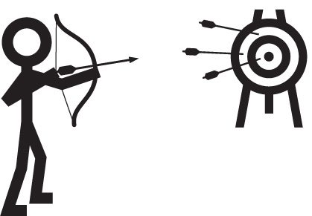
Archer
Stand with your legs wide, then turn to one side.
Lift your arms to draw a bow and shoot the arrow.

Slide 11
Elephant
Put one arm behind your back.
Lift the other arm like an elephant’s trunk.
Flop down to touch the floor.

Slide 12
Rag doll
Stand up tall, put your hands on your thighs.
Let your head droop. Slide your hands to your feet.
Sway side to side, then stand up slowly.

Slide 13

Windmill
5 little men in a flying saucer.
Stand legs apart, hands held above head.
Make a big circle with hands.

Slide 14
Flank forward bend
From standing, one leg forward, hands in prayer.
Arms wide, then arms up.
Bend to knee then toes, then back to prayer.

Slide 15
Forward bend
Row Row Row Your Boat
Hands on knees, reach down to toes.
Hands above head, reach to toes and make a noise.

Slide 16
Palming
Breathe in, lifting your hands out to the side.
Then out, bringing them back down to your knees.
Rub your hands together, then put over your eyes.

Slide 17
Stir the pudding
Sit with legs apart. Both hands hold the spoon.
Reach to one foot and sweep across to the other
making a circular movement.

Slide 18
Swan stretch
Kneel on the mat with your arms out in front.
Put your head on your mat and hold.

Slide 19
Cat
From Swan stretch, kneel up on all fours.
Look up to the ceiling and stick your bottom up too.

Slide 20
Dog
From Cat, tuck your toes under.
Lift your bottom up with straight legs.
Look at your feet.

Slide 21
Child
Kneel down with your bottom on your heels.
Bring your hands towards your feet and hold.

Slide 22
Cobra
Lie on your front with your hands by your shoulders.
Push up with your hands and look up.

Slide 23
Savasana
Lie flat on the mat and relax.
Breathe in and raise your arms above your head.
Breathe out and put them back to your side.

Slide 24
Leg raises
Lie on your back. Bring your knees to your chest.
Breathe in as you straighten one leg.
Breathe out as you curl back up. Repeat.

Slide 25
Bridge
Bend your knees and keep your arms by your side.
Push down on your feet and lift your bottom up.

Slide 26
Twist
Lie on your back.
Put your arms out at shoulder level, knees bent.
Turn your knees to the side keeping shoulders on floor

Slide 27
Spinal rocking
Lie on your back. Hug your knees to your chest.
Push your knees away, then pull them in.

Slide 28
Lion breath
Sit cross legged on your mat.
Breathe in and stretch your arms out to the side.
Breathe out and roar like a lion.

Slide 29
Bee breath
Sit cross legged on your mat.
Put your thumbs on your jaw, fingers on temples.
Breathe in then hum out like a bee.

Slide 30
Aum
Sit cross legged on your mat.
Make yoga fingers and rest them on your knees.
Breathe in slowly, then say “om” as you breathe out.

Slide 31
Relax
Lie comfortably on your mat.
Listen to the music and think about your breathing
and your body. Listen to the relaxation.

Slide 32

Visualisation
Lie comfortably on your mat.
Listen to the words and think about your breathing
and your body.

Slide 33
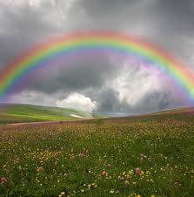
Rainbow
Visualisation
Lie comfortably on your mat.
Listen to the words and think about your breathing
and your body.

Slide 34
Sit up
Slowly come to a sitting or kneeling position.
Stretch out your back.

Slide 35
Stretch and yawn
Sit cross legged on your mat.
Breathe in and reach your arms up high.
Yawn out and wiggle your fingers down to the side.

Slide 36
Yoga is finished
Sit up slowly.
Roll up your mat and put it away.

Slide 37
Yoga
Intermediate Routine

